Slide 1


Unleashing the Power of AI Builder. Image and Form Recognition
Global Power Platform Bootcamp
Denis Molodtsov

Slide 2

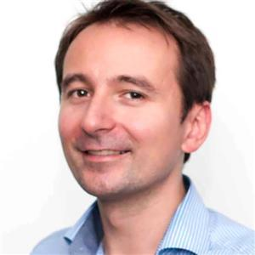
Delivered over 100 customized SharePoint Projects
Denis Molodtsov
SharePoint & Office
365 Architect
My GitHub is github.com/zerg00s
My LinkedIn is linkedin.com/in/molodtsovd
I live in Toronto and work at TD Bank

Slide 3
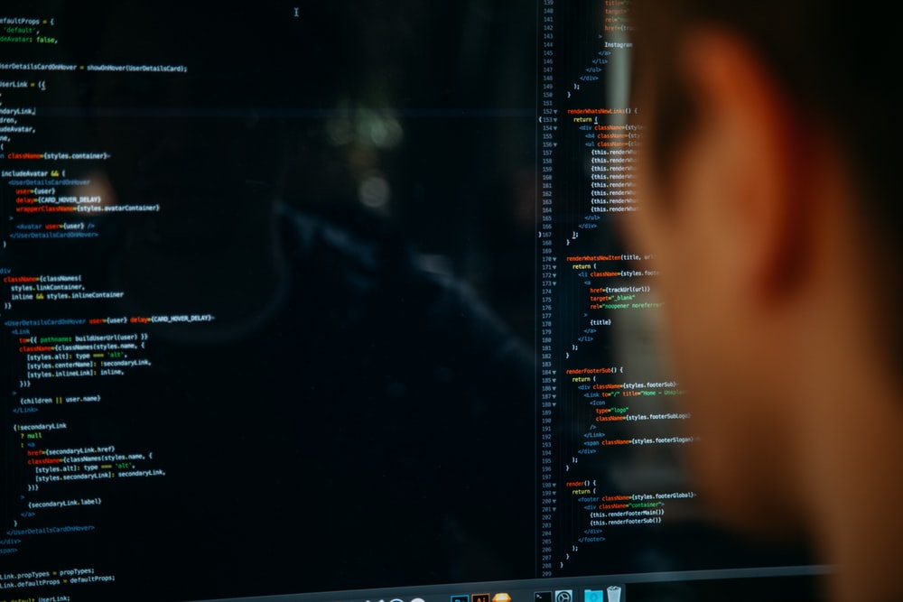
AI has become more accessible

Slide 5
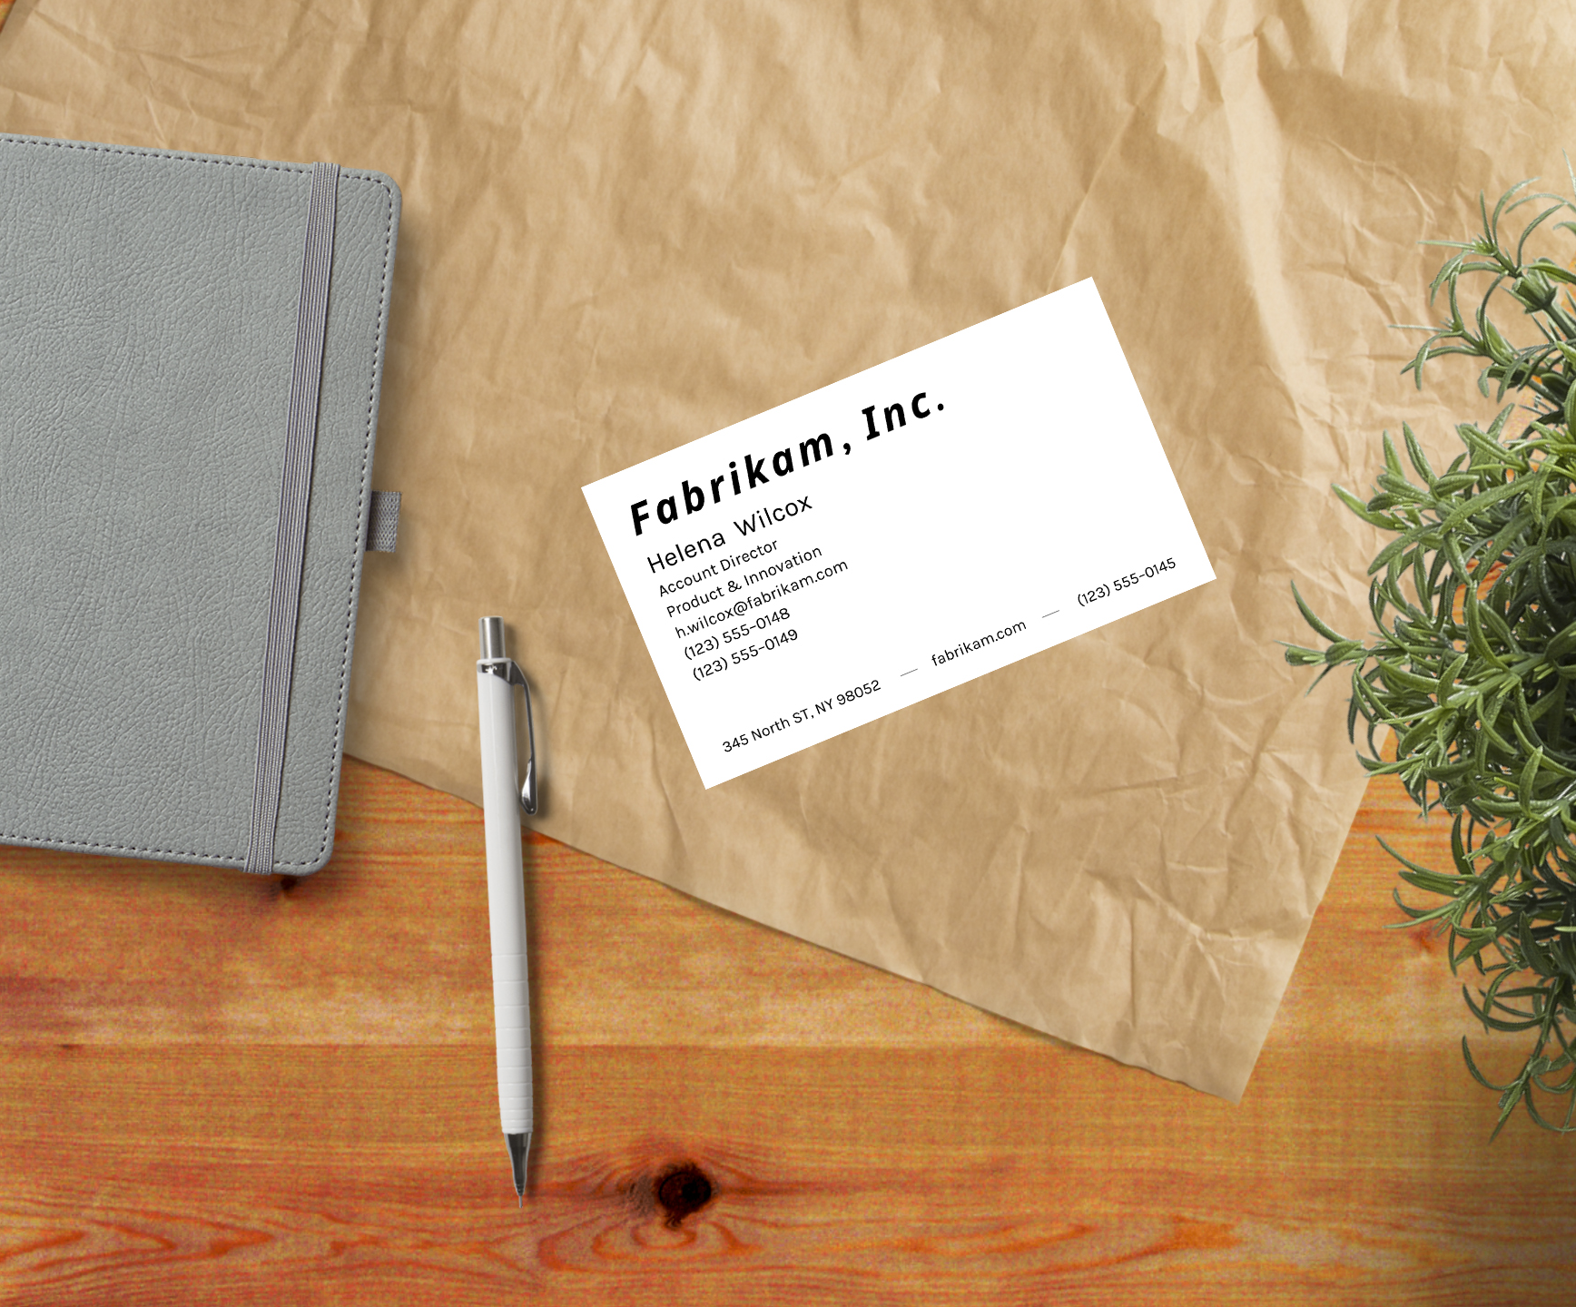
Business Card Scanning

Slide 6
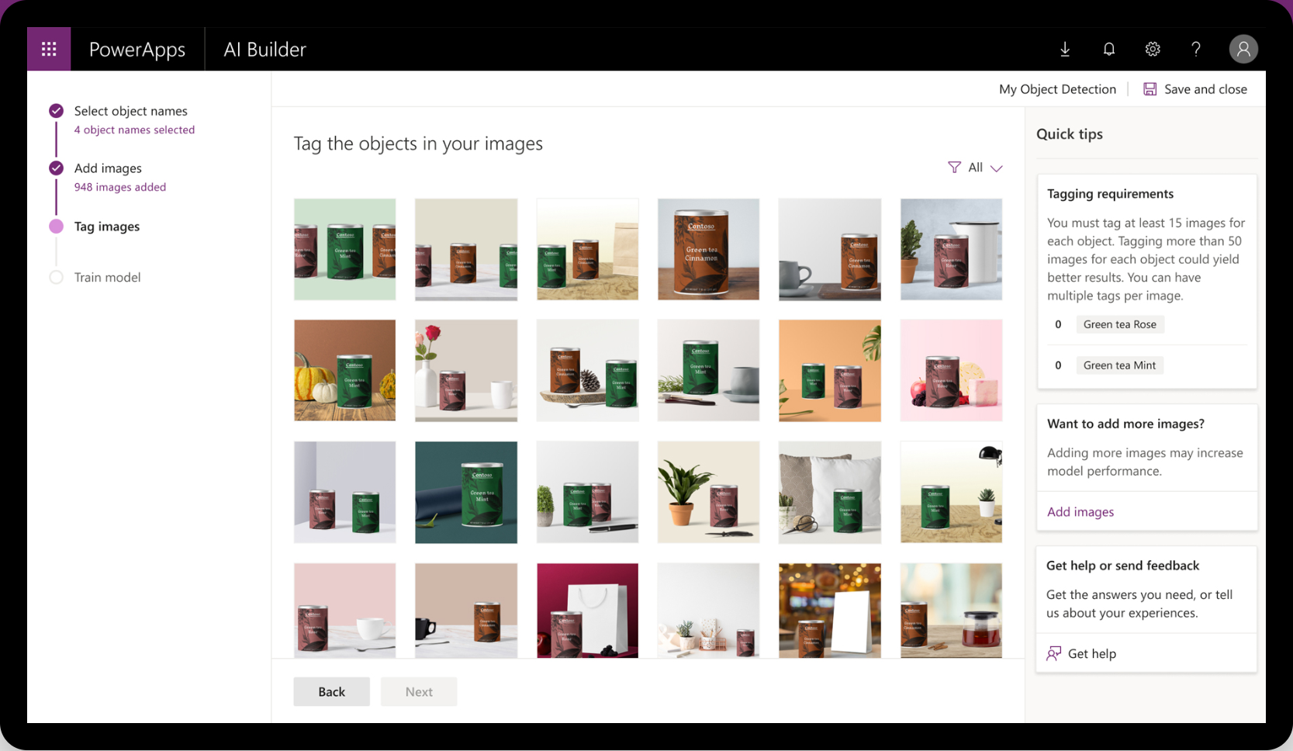
Demo
Business card reader

Slide 7
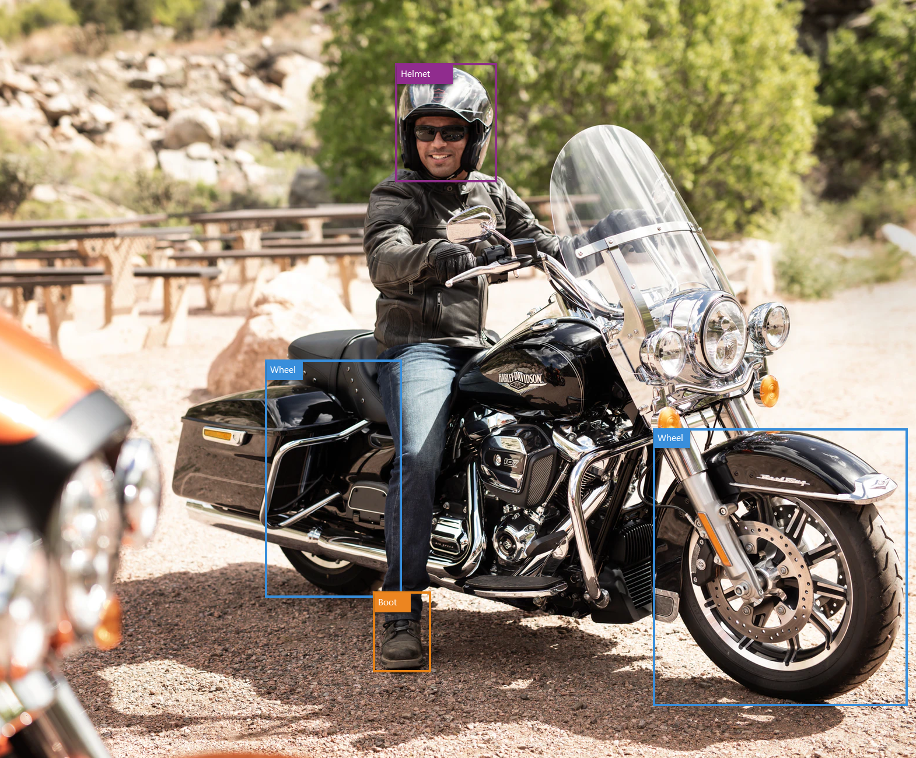
Object Detection

Slide 8
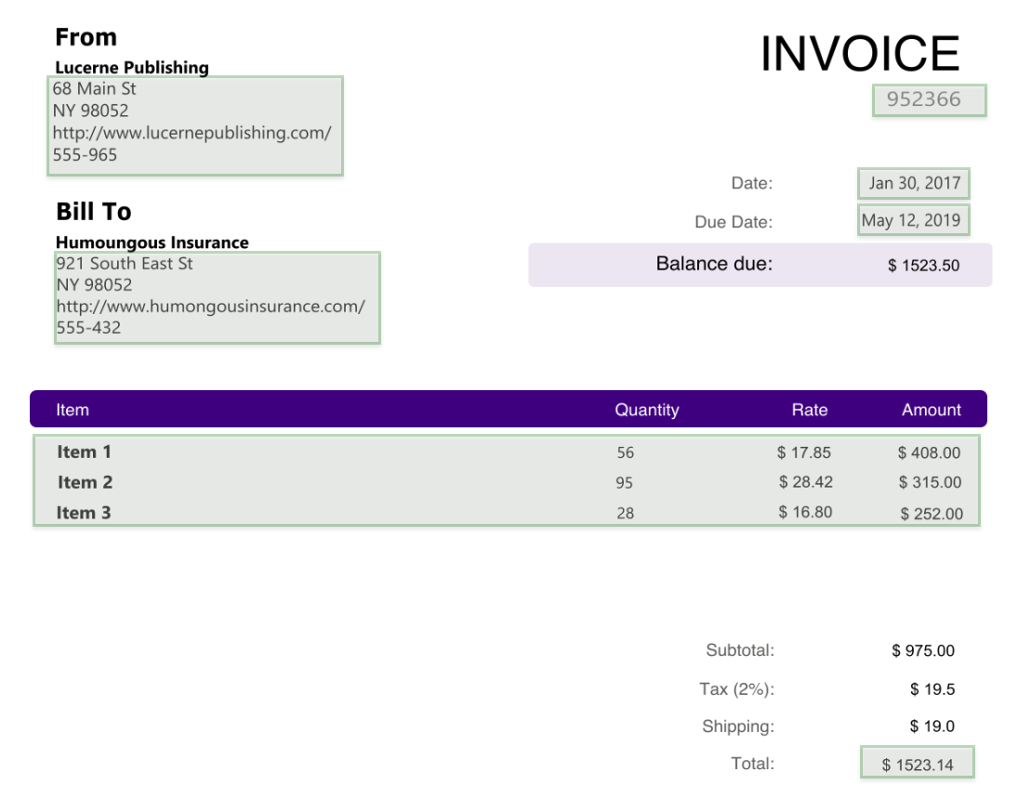
Form processing

Slide 9

Train Custom AI Model

Slide 10
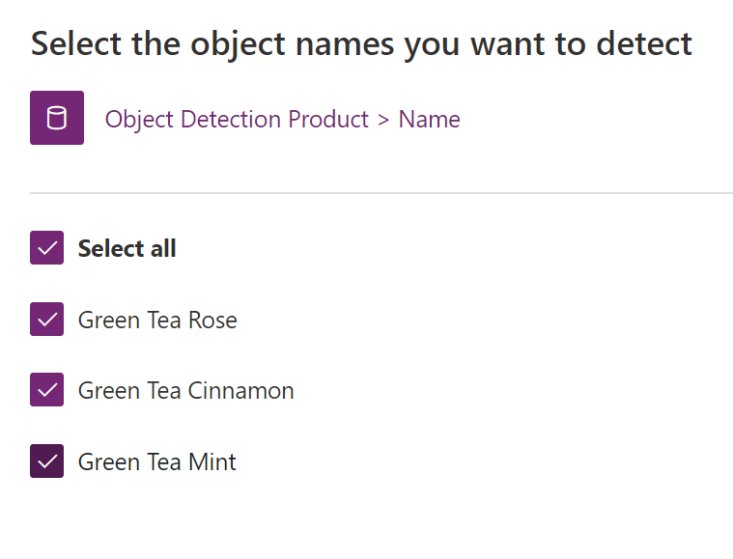
Step 1
Define Object Names

Slide 11
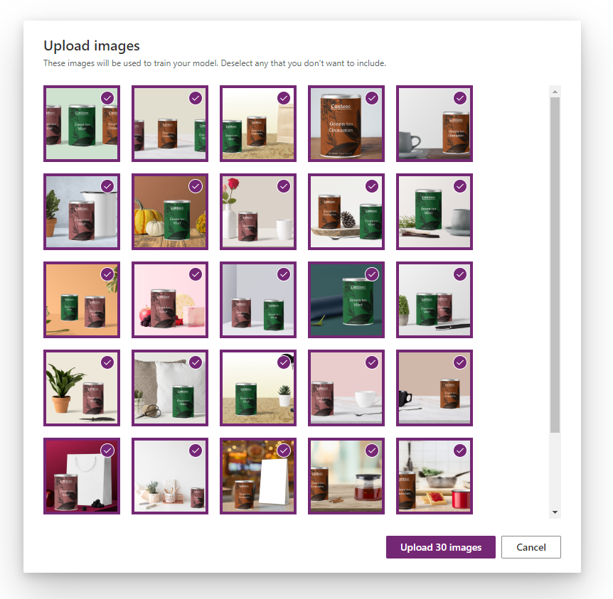
Step 2
Upload Training Material

Slide 12
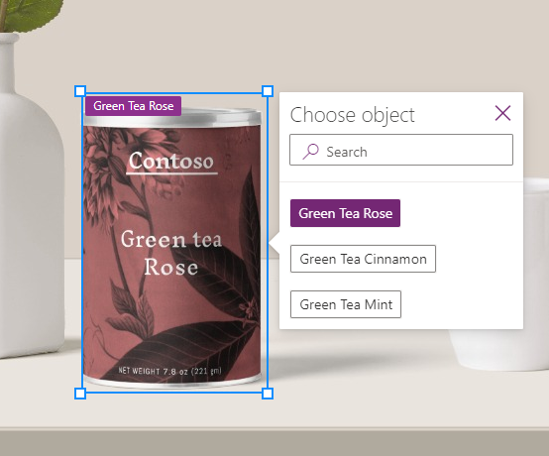
Step 3
Tag Objects Manually

Slide 13
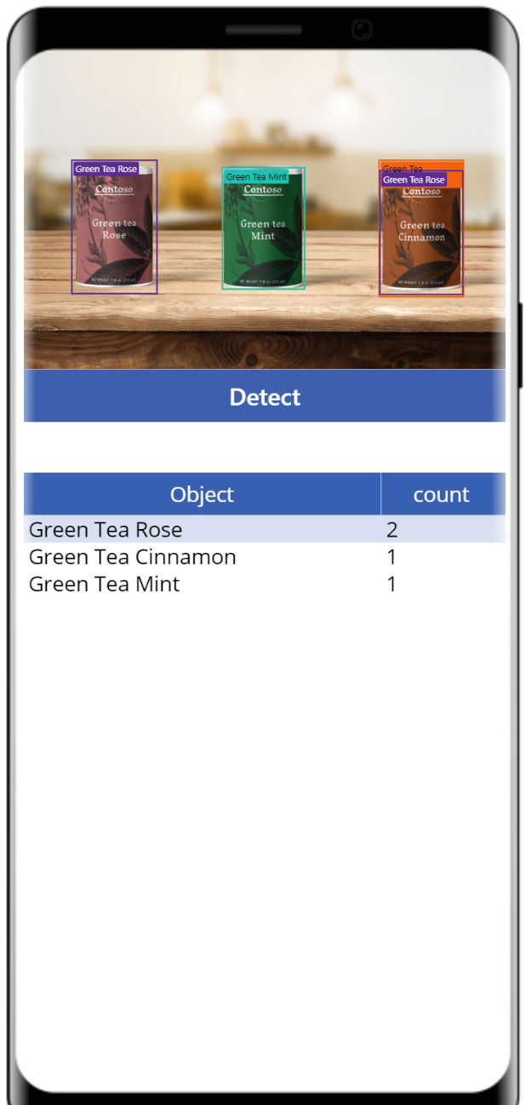
Step 4
Use the AI model

Slide 14
Demo
Form processing & Text recognition

Slide 15
Thank you!
Denis Molodtsov
SharePoint & Office
365 Architect
My GitHub is github.com/zerg00s
My LinkedIn is linkedin.com/in/molodtsovd
I live in Toronto and work at TD Bank

